Slide 1
Genscan predicted gene exon
Official gene exon

Slide 2

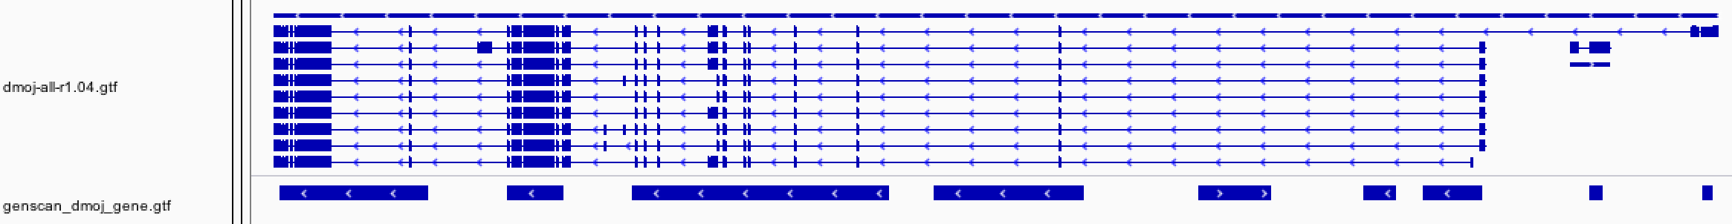
Total predicted genes and the reasons for gene over-prediction
Official gene regions
Predicted gene regions
Official gene regions
Predicted gene regions

Slide 3
Genscan predicted gene region
Official gene region

Slide 4

Shorter predicted size that the official gene

Slide 5
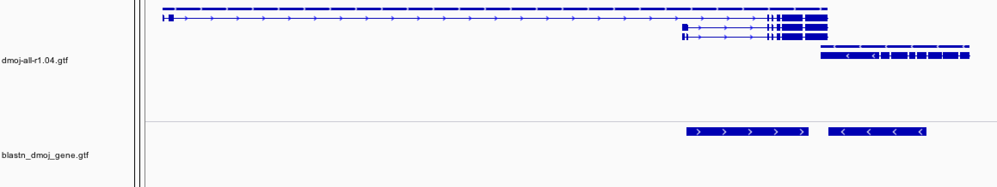
Problem for the blastn annotation

Slide 6
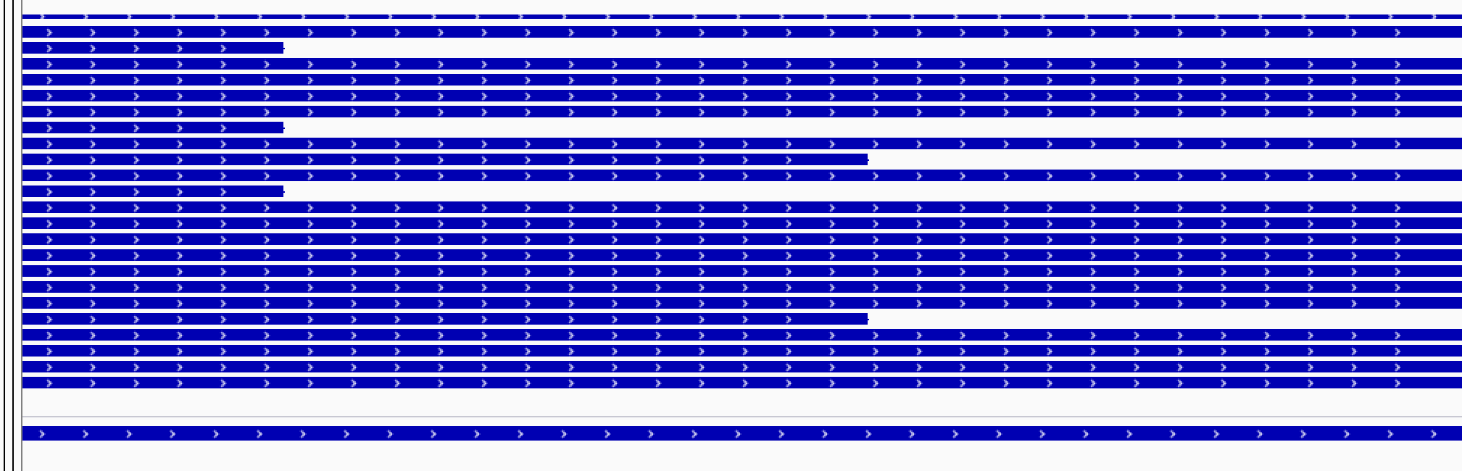
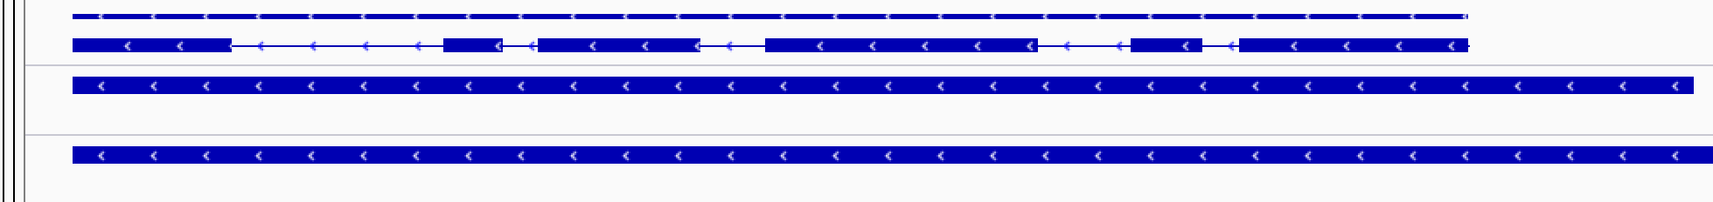
Case 1
Official gene regions
Predicted gene regions
Case 2
Official gene regions
Predicted gene regions

Slide 8
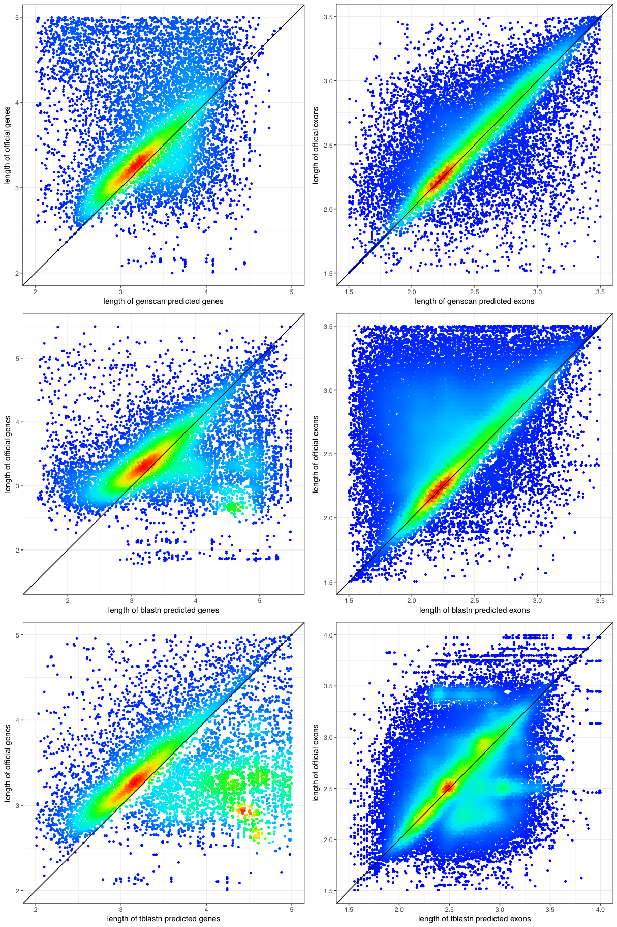

Slide 9
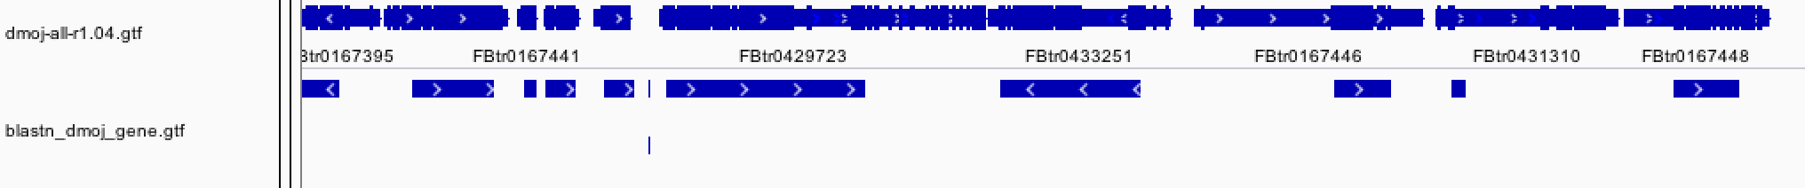


Slide 10
